Slide 1

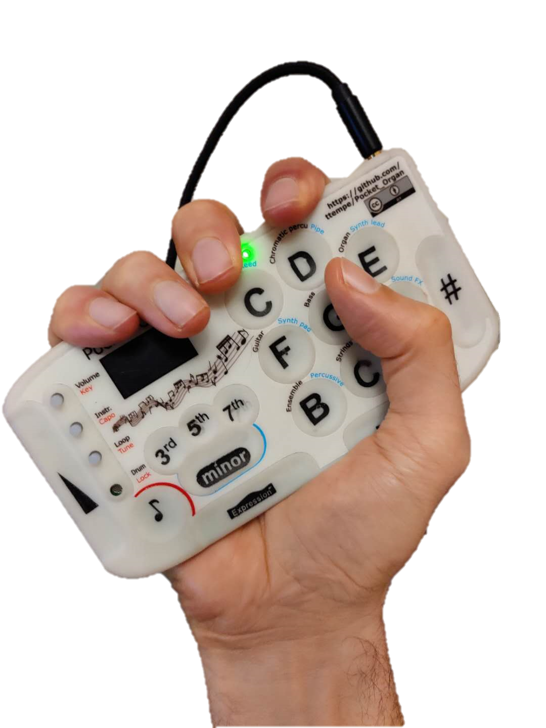
Pocket organ 口袋琴
Very few instruments are actually modern. Most of them have centuries-old user interfaces, constrained by the limits of woodworking and the need to produce sound. What if we were to design an instrument today? I want mine to fit in my pocket, be easy and fun to learn, and be expressive, cheap, open source, and easily hackable.
实际上当下很少有乐器可以被认为是现代的，受限于几百年前的制作工艺和材料，大部分乐器的用户界面都有着数百年的历史。如果我们按现代的技术与人体工程设计一款乐器，它会是什么样的？我希望它能轻松地塞在衣服口袋里，易学好用，有充分的表现力，便宜，开源，并且有容易更改的设计代码。
_{Maker Name: Thomas TEMPE 唐沛}
_{Project Picture}

